Slide 1

Integrating Large Language Models into Reinforcement Learning
Gregor Kajda, Jonatan Hoffmann Hanssen, Adrian Duric
Supervisors: Katrine Nergård, Kai Olav Ellefsen

Slide 2
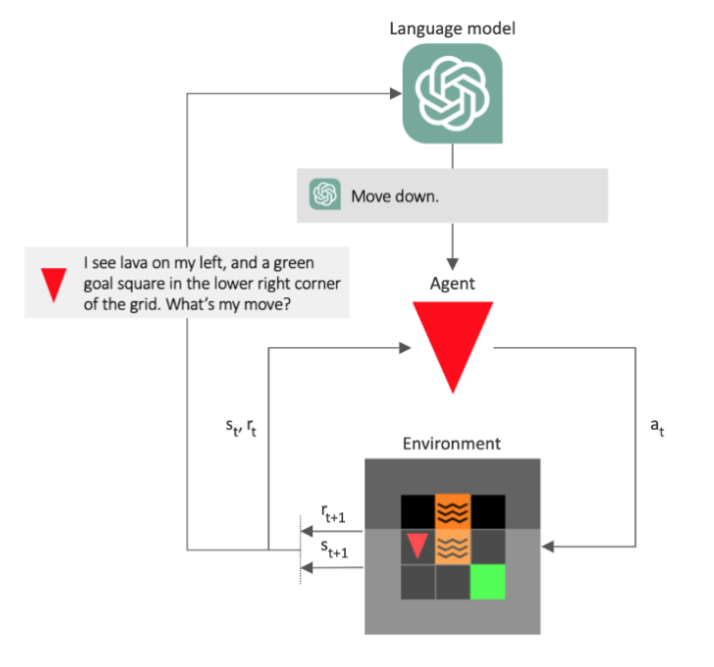
Aim of the Project
RL in large environments
Large state and action spaces
Poor sampling efficiency
LLMs can make the agent try smarter actions
Our goal: integrate an LLM into the RL framework

Slide 3
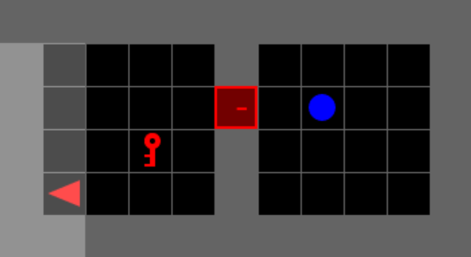
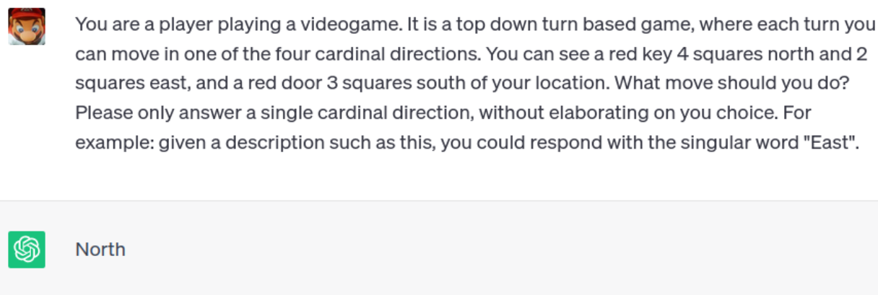
Our Approach
LLM as policy
LLM gets state prompt
Answer becomes RL agent policy
LLM as reward
LLM gets state prompt
Returns recommended action
Similar actions to recommended one are rewarded
Above: Farama 2023, Minigrid. Screenshot by author. Below: Example prompt to LLM, and LLM response.

Slide 4
Current State (!) of the Project
Achieved so far
LLM can control agent directly in Minigrid environment
Soon implemented conventional RL baseline (PPO)
Can reward similarity between observation and LLM recommendation
To be improved
LLM (Llama 2) is... not smart
Agent still not actually trained by LLM actions
Final architecture not decided upon yet

Slide 5
Where We’re Headed
Establish conventional RL baseline
Integrate LLM into Architecture
Finalize Proximal Policy Optimization (PPO)
Measure results
Decide: LLM as policy or reward?
Automate communication between LLM and RL agent
Fit into RL framework
Testing and evaluation
Our results vs. PPO only?
Sampling efficiency improved?

